Slide 1
DNA Replication

Slide 2
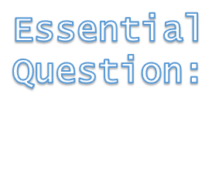
Syllabus:
The structural properties of the DNA, including nucleotide composition and pairing and the hydrogen bonds between strands of DNA allow for replication
Describe the process of DNA Replication
State the enzymes involved in DNA replication and describe their role

Slide 3
What you need to complete
Read Chapter 3 Biology WA ATAR Units 3 & 4
Answer Biology WA ATAR Question Sets
    Set 3.3 pg. 63 Q1 – 5
    Set 3.4 pg. 65 Q 1 – 4
    Set 3.5a pg. 66 Q 1 – 4
    Set 3.5b pg. 69 Q 1 – 4
    Set 3.5c pg. 73 Q 1 – 4
    Set 3.6 pg. 75 Q 1 – 5
    NOTE: Some of these question have been used in this PPT and the note taking scaffold. These are to be completed over 2 weeks
Biozone Activities
    120
    121
    122
    123
    124
    126
    127
    128
    129
    130
    195

Slide 4
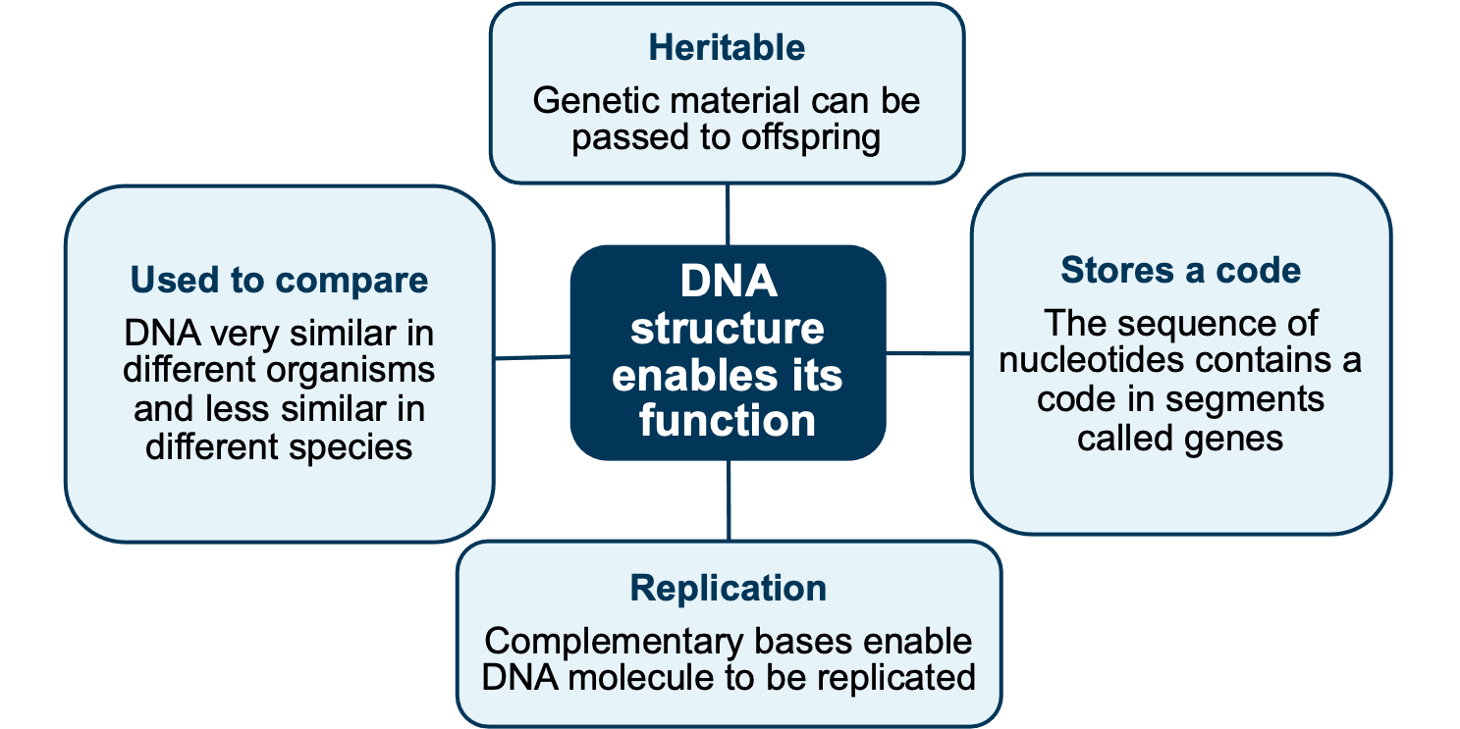
DNA structure & function
REVISION – DNA function is linked to its structure
Because it can be replicated it can be passed from parent cell to daughter cell
All living things contain DNA
Weak hydrogen bonds mean they can be easily broken the 2 strands of DNA separated
These genes code for proteins or RNA

Slide 5
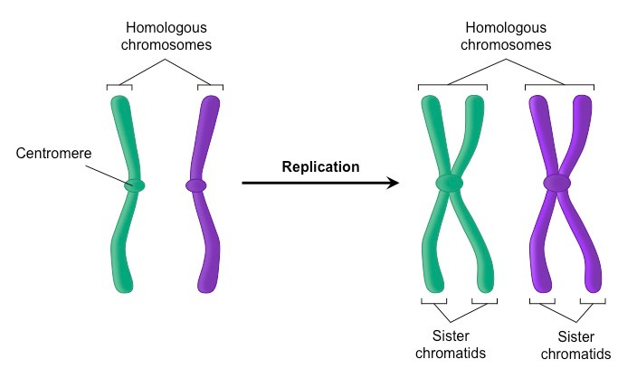
Topic Question 1: Describe the purpose of DNA replication
DNA replication
The purpose of DNA replication is to duplicate the code it carries. The code can then be passed to daughter cells.
In eukaryotic cells, the chromosomes gain a sister chromatid and become double stranded.
DNA replication occurs in the preparation for all cell division, whether mitosis or meiosis
Process ensures that each daughter cell or gamete receives a complete set of genes from the original cell and has the correct number of chromosomes
Before Replication
After Replication

Slide 6
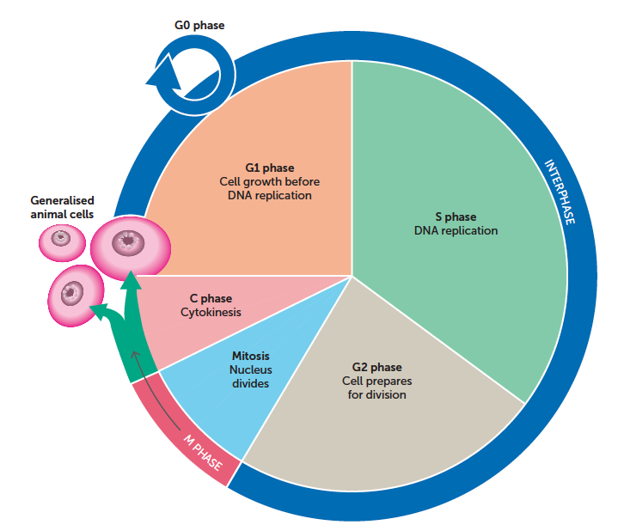
Topic Question 2: When does DNA replication occur?
DNA replication occurs during interphase of the cell cycle in preparation for mitosis or meiosis.

Slide 7
Topic Question 3: What enzymes are involved in DNA replication?
DNA replication is controlled by several different enzymes
Yr 11 Recap – What is an enzyme?
Enzyme
DNA Helicase
RNA Primase
DNA polymerase
DNA ligase

Slide 8
Topic Question 3: Use a labelled diagram to describe the process of DNA replication

Slide 9
DNA replication − process
Topic Question 3: Describe the process of DNA replication
Step 1
DNA helicase (enzyme) unwinds and separates the double strand by breaking the weak hydrogen bonds.
This exposes the nucleotides of each half of the parent molecule so they can be used as a template.
This separation occurs along a small section at a time

Slide 10
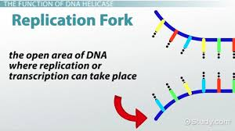
Topic Question 3: Describe the process of DNA replication
Step 1
The unwinding of the DNA strands by DNA helicase forms a junction between the unwound single strands of DNA and the intact double helix called a replication fork
The replication fork moves along the parental DNA strand so there is a continuous unwinding of the parental strands
These parental strands provide a ‘template’ for the new strand’s synthesis

Slide 11
DNA replication − process
Topic Question 3: Describe the process of DNA replication
Step 2
The enzyme RNA primase attaches a short sequence of RNA nucleotides, known as a primer to the template strands
This short stretch of RNA provides nucleotides that DNA polymerase can extend

Slide 12
DNA replication − process
Topic Question 3: Describe the process of DNA replication
Step 3
DNA polymerase attaches to the DNA template strands
NOTE : Key features of DNA polymerases
  Always needs a template
  Can’t start making DNA from scratch, but requires a pre-existing chain or a short stretch of nucleotides called a primer (starter)
  It also only synthesises DNA in one direction from a 5’ to 3’ direction
  They proofread or check their work by removing the vast majority of ‘wrong’ nucleotides that are accidentally added to the chain

Slide 13
DNA replication − process
Topic Question 3: Describe the process of DNA replication
Step 3
Within the nucleus, stockpiles of free nucleotides in the nucleoplasm attach to the exposed bases according to the base-pairing rule with the help of the enzyme DNA polymerase
Synthesis of the new daughter strand is in a 5’ to 3’ direction.
Adenine pairs with thymine, and cytosine pairs with guanine.

Slide 14
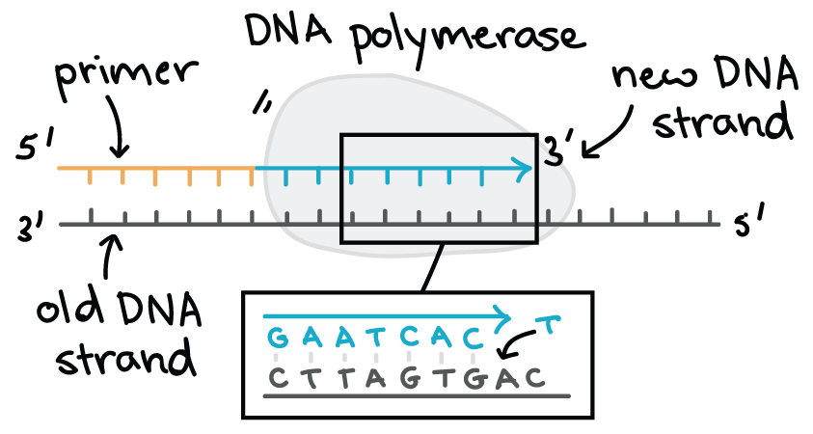
Topic Question 3: Describe the process of DNA replication

Slide 15
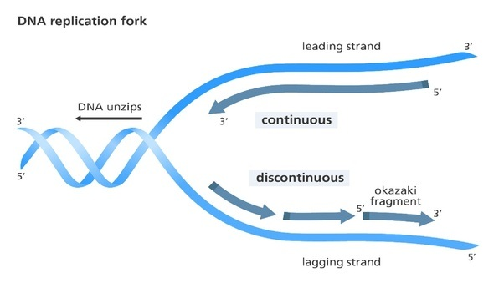
DNA replication − process
Topic Question 3: Describe the process of DNA replication
Step 3
On the leading strand, DNA polymerase is moving towards the replication fork and synthesis is continuous in a 5’ to 3’ direction, meaning DNA polymerase adds nucleotides continuously

Slide 16
DNA replication − process
Topic Question 3: Describe the process of DNA replication
Step 3
On the lagging strand, DNA polymerase is moving away from the replication fork in a 5’ to 3’ direction and copying is discontinuous
Lagging strand is formed in fragments called Okazaki fragments

Slide 17
DNA replication − process
Topic Question 3: Describe the process of DNA replication
Step 3
Okazaki fragments are formed because DNA polymerase lays down nucleotides from a 5’ to 3’ direction away from the replication fork
RNA Primase adds primers at intervals along the lagging strand and DNA Polymerase adds nucleotides between primers

Slide 18
DNA replication − process
Topic Question 3: Describe the process of DNA replication
Step 4
Then DNA polymerase removes RNA primers which is a short strand of RNA and replaces it with DNA nucleotides

Slide 19
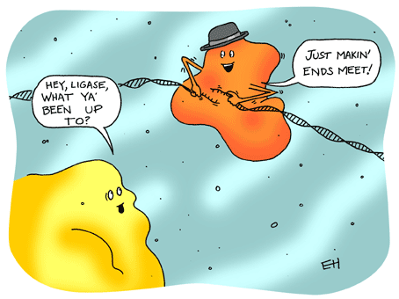
DNA replication − process
Topic Question 3: Describe the process of DNA replication
Step 4
An enzyme called DNA ligase joins the short stretches of nucleotides into a continuous strand that rewinds

Slide 20
DNA replication − process
Topic Question 3: Describe the process of DNA replication
Step 4
The result is the production of two identical DNA molecules that are each made of one parent strand and one new daughter strand.
The new DNA molecules each contain half original and half new material
Therefore, the process is described as semi-conservative.

Slide 21
DNA replication − process
Topic Question 3: Describe the process of DNA replication
Step 5
In eukaryotic organisms, two sister chromatids are now ready for cell division.
In prokaryotes, two circular chromosomes are now ready for binary fission.

Slide 22
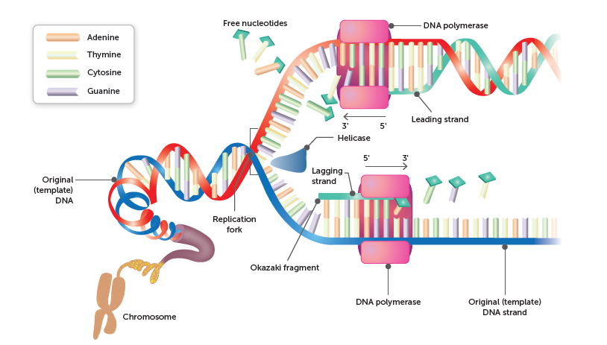
DNA replication − models
Topic Question 3: Evaluate the two models of DNA replication below. State two advantages and disadvantages of each model
Model 1
Model 2

